Slide 1
#73 Gamification-based education platform
for sustainable agricultural and environmental applications
David Huang & Jesse Zeng
David Huang & Jesse Zeng
Notes:
10 s
Hello, I am David and this is my partner Jess for project 73. We will be talking about the architecture of our AR application.

Slide 2
Technical
Stack
Augmented Reality Planting Game
Implementation for Android devices
Using Unity as development tool
AR foundation
XR interaction Toolkit
C#
Icon - FlatIcon
Notes:
20 s
We’ll focus on developing our app for android devices. The application is developed through the use of the unity software as they provide the best libraries and tools for making AR apps. These tools are AR foundation and XR interaction toolkit. Since we are using unity, we will be coding our application in C#.

Slide 3
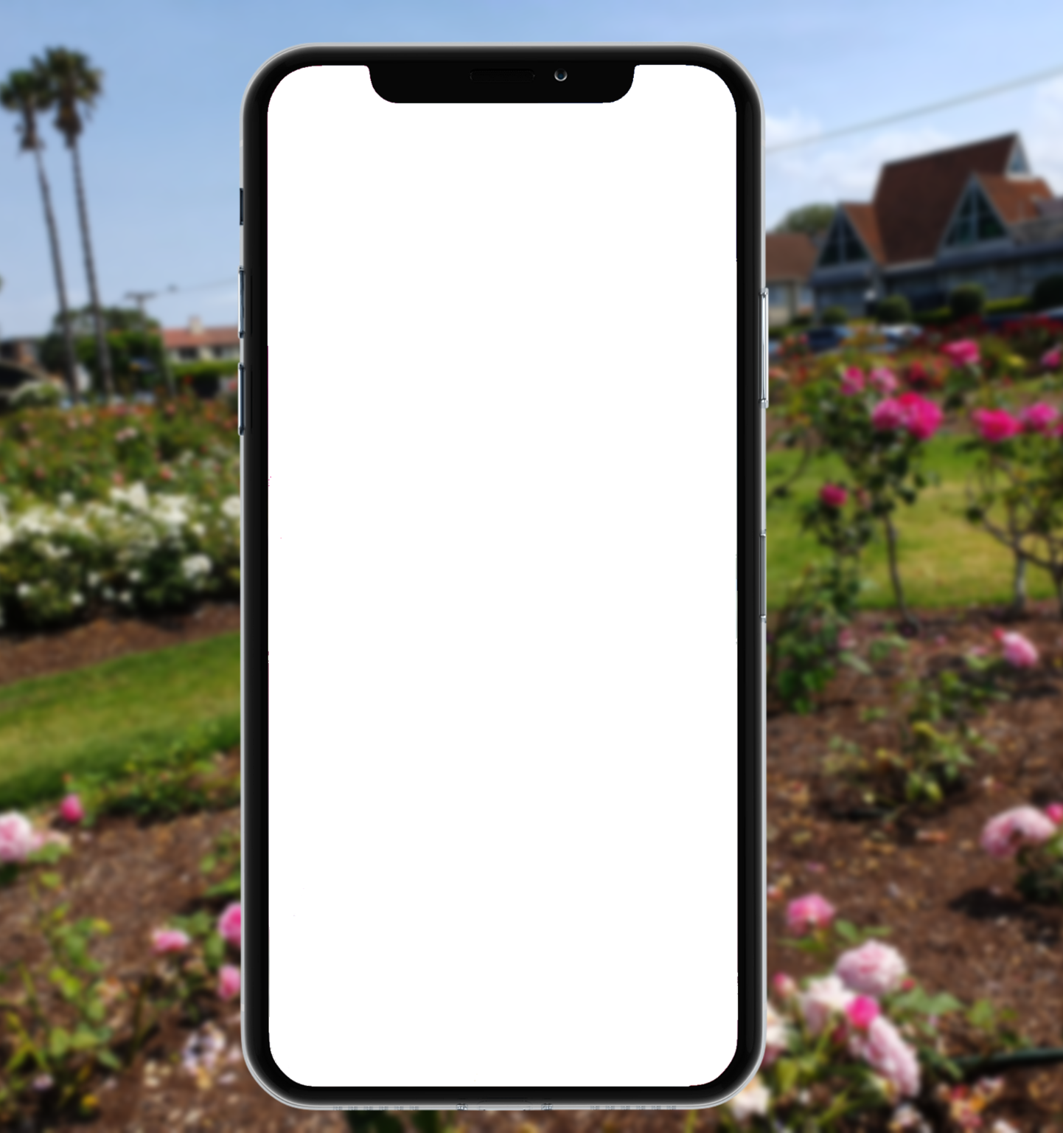
Game Modes
Main Menu
Choose your mode
Virtual Plant Mode
Real Plant mode
Notes:
10 s
Our AR game consists of two modes, the virtual plant mode and the real plant mode that the user can select in the main menu.

Slide 4
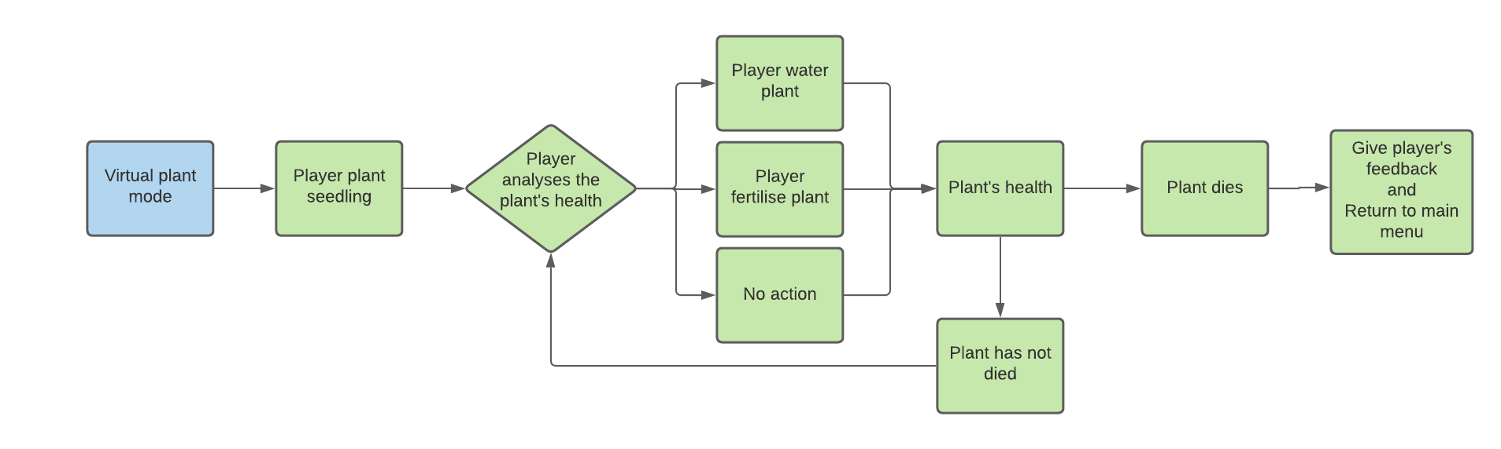
Virtual plant mode
Notes:
40 s
We’ll start off with the virtual plant mode where the player can grow their apple tree virtually.
The virtual plant mode begins with the player planting a virtual seeding on a soil
From the plant’s appearance, the player can choose to either water, fertilise or do nothing to the plant.
The player’s action will therefore affect the plant’s health. If the plant has not died which means it has still the potential to grow, the player can decide their interaction with the plant again.
However if the plant has died
then the game gives the player’s feedback of their playthrough and returns back to the main menu where the player can choose to play the game again.

Slide 5
Virtual Apple Tree Growth Cycle
01
02
03
04
Seed
Sapling
Small Tree
Full-Grown Tree
Day 0 to Week 2
Week 2 to Year 2
Duration: ≃ 2 years
Year 2 to Year 6
Duration: 4 years
Year 6 to Year 7 +
Tree can flower and be harvested
Duration: 1 year to harvest
The tree only grows when it is healthy
Growth is calculated at 0.036% per day growth, 100% at year 7
Notes:
40 s
In terms of the plant’s growth cycle, there are four growth stages. Stage one representing the seedling, stage two representing the sapling, stage three representing a small tree, and finally the final stage represents a fully mature apple tree.
Each stage requires a certain amount of time to reach the next stage. Seedling requires 2 weeks to grow into a sapling. Sapling requires around 2 years to grow into a small tree. Finally, small tree will take 4 years to be a fully grown apple tree. It will take another year for the tree to be fully harvestable.
The duration of the growth cycle is based on a real apple tree.
The plant’s growth is represented in percentages where it grows 0.036% per day resulting in a 100% growth after 7 years.
We made a condition where the tree must be healthy for it to grow. This will be explained in the later slides.

Slide 6
Fertilisation and Irrigation
Common
Nutrient (N) and water (W) levels are recorded as percentages
The plant starts with 50% water and nutrient level when planted
0% - 50% lack of nutrients / water
50% - 100% healthy nutrients / water level
100% - ∞% too much nutrients / water
Fertilisation (N)
Based on fertilising the plant once per year
Fertilising the tree will increase the nutrient level by 50%
Nutrients level decreases by 50% per year
Irrigation (W)
Based on watering the plant once every 7 - 10 days
Watering the tree will increase the water level by 50%
Water level decreases 5% per day
Notes:
40 s
The plant is affected by two factors in which the player has control of. These two factors are fertilisation and irrigation which affect the nutrient and water levels of the tree respectively.
The nutrients and water levels are represented as percentages.
The range 0 - 50% indicates insufficient levels whereas 50% - 100% represents a healthy amount. On the other hand, 100% and over displays excessive levels of water and nutrients.
At the beginning of the game, The plant starts with 50% water and 50% nutrient level when planted.
Firstly, The player should fertilise the tree once every year. Nutrients levels decrease by 50% per year, thus fertilising the tree, increases the levels by 50%.
On the other hand, the player should irrigate the tree once every 7 - 10 days depending on a number of factors. Water levels decrease by 5% per day and watering the plant increases the levels by 50%.
For the next slide, Jess will explain how rainfall, sunlight and temperature affects the water levels of the plant.
//////////////////////////split////////////////////////////

Slide 7
Use of IoT Data
Rainfall
Rain waters the plant
Affects the rate the plant water level decreases
More rainfall => slower decrease E.g weekly rainfall of 2.5cm will halve the rate of decrease
Used to make recommendations to the player
E.g discourages the player to water the tree when there is heavy rainfall
Sunlight & Temperature
Sunlight and higher temperatures removes water from the soil
Affects the rate the plant water level decreases
Increased sunlight and/or higher temperature => faster decrease
Notes:
40 s
Rainfall, sunlight and temperature influence how plants grow in real life and we will use this in IoT data form in attempt to replicate the real environment in the virtual world.
Rainfall waters a plant, which will be reflected by slowing down the rate of water decrease in the virtual tree.
For example, weekly rainfall of 2.5cm would halve the rate of water level decrease per day.
The rainfall information will also be used to make recommendations to the player.
Sunlight and the temperature influences soil moisture levels too.
This data will be used together with rainfall to determine the rate of water level decrease in the tree.

Slide 8
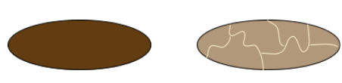
Plant Health
Plant’s Health Status
Healthy → When Nutrient (N) and Water (W) levels in the range of 50 - 100%
i.e. (N & W) >= 50% & (N & W) <= 100%
Unhealthy→ When Nutrient (N) and Water (W) levels not in the range of 50 - 100%
i.e. (N or W) < 50% or (N or W) > 100%
The tree can die from a disease when it is unhealthy for a certain amount of time (Dependent on the plants’ stage)
Recommendations are given to the player when tree is unhealthy
e.g “It is a rainy week, consider watering the plant less”
Plant Health Indicators
The game shows 2D images of the plant’s leaves, trunk and soil to the player
Helps player decision to water or fertilise the tree or not take any actions
Good soil
Dry soil
Notes:
40 s
Following on, the water and nutrient levels influence the plant’s health in the game. When both the nutrient and water levels are within the 50% to 100% range, the plant is healthy. However when not in this range, the plant will be classified as unhealthy. After a period plant unhealthiness depending on the stage of the tree, the plant may start to die from disease. Recommendations are given to the player to help with an unhealthy tree. There will also be plant health indicators in the form of 2D images of the tree leaves, trunk and the soil. These images aim to help the player in make informed decisions in the game.

Slide 9
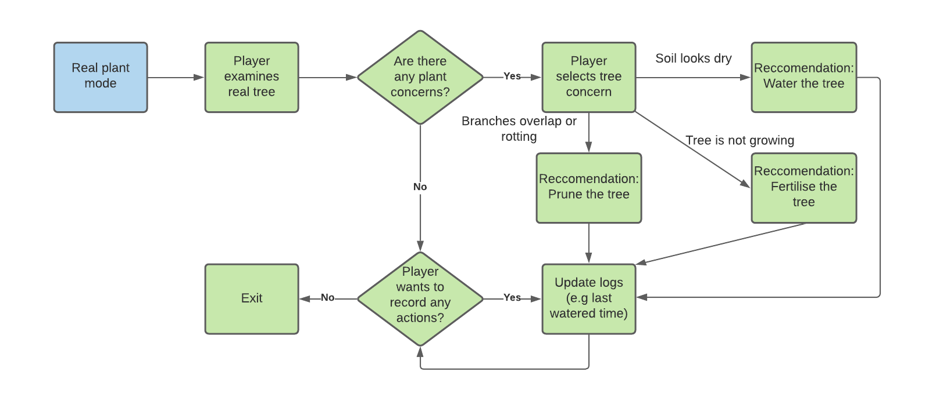
Real Life Planting Mode
Notes:
40 s
Next I will discuss the real life planting mode for our game. This mode acts as an assistant to help the player with their tree. Therefore, we assume the player has already planted their tree before using the app. The game flow of this mode relies entirely on the players input. There is a help menu where the player can get advice if they see a problem or concern with the tree. For example if they select that the soil looks dry, our game will recommend to water the tree. An action recording system will also record data such as the date and time of when the tree was watered last if the player wishes to record this.

Slide 10
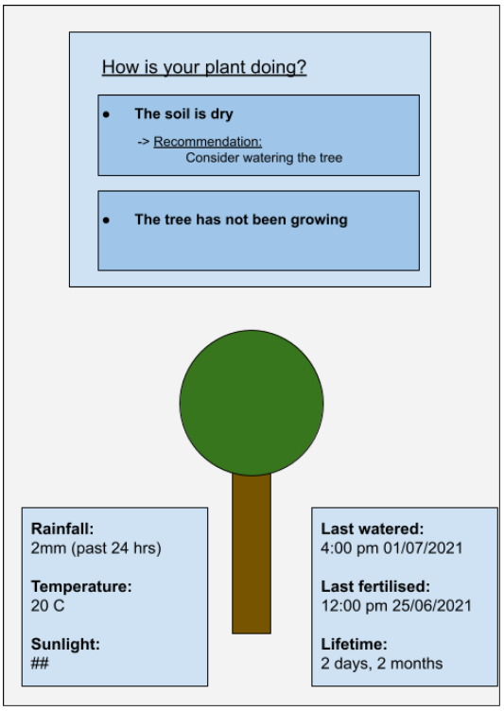
Real Life Planting Mode
Icon - FlatIcon
Notes:
30 s
This is a design concept for the real life planting mode. At the top is the help menu with the various plant problems or concerns that the player can select. On the bottom right is the action recording system mentioned previously showing the last watered time. The real plant mode will also display the IoT data such as rainfall and temperature. We intend to display this information in a visualisation that will help the player make informed decisions about their tree.

Slide 11
Project Progress & Next Steps
Jesse
Backend Implementation
Plant health system
IoT data manipulation
Expanding on using IoT data and correlating the effects on the plant levels and health.
David
Frontend Implementation
Application UI
AR Model of the plant
Investigate a plant disease to apply in the game
Notes:
30 s
The next steps for our project is to continue the implementation of the game. I am in charge of backend implementation which is associated with the plant health system and incorporating the IoT data into the calculations. I will also be expanding on the use of IoT data and the resulting effects on the plant.
For my part, I am in charge of frontend implementation which deals with implementing the application UI and AR model of the plant. I will also be investigating various plant diseases to apply in the game.
Thank you for listening.

